Slide 1
Representing Data Elements
Chapter 3

Slide 2
Outline
Data elements and fields
Records
Representing Block and Record Addresses
Variable-length Data and Records
Record modifications

Slide 3
Introduction
Attributes need to be represented by fixed- or variable-length sequences of bytes, called “fields”
Fields, in turn, are put together in fixed- or variable-length collections called “records”.
Records are stored in blocks. They can be reorganized when the database is modified.
A collection of records that forms a relation is stored in a collection of blocks.

Slide 4
Representing relational data elements
Consider the following DDL
CREATE TABLE MovieSrar(
  name char(30) PRIMARY KEY,
  Address VARCHAR(255),
  Gender CHAR(1)
  Birthdate DATE
  );
How do we represent SQL data types as fields ?
How do we represent tuples as records ?
How do we represent a collection of records in a blocks of memory ?
How do we represent and store relations as collections of blocks ?
How do we cope with record sizes that may be different for different tuples or that do not divide the block size evenly or both?
What happens if the size of the record changes because some field is updated ? How do we find the space in the block when the record grows ?
How to represent objects and blobs ?

Slide 5

Disks
Mechanics of Disks

Slide 6
Representing Data Elements
We have only bytes
  8-bit units
We want to represent
  a salary
  a name
  a date
  a picture
OS stores file as a sequence of bytes.
We want to store table as sequence of tuples. How to do?

Slide 7
To represent:
Integer (short): 2 bytes
e.g., 35 is
00000000
00100011
Real, floating point
  n bits for mantissa, m for exponent….

Slide 8
To represent:
Characters
→ various coding schemes suggested,
most popular is ascii
Example:
A: 1000001
a: 1100001
5: 0110101
LF: 0001010

Slide 9
To represent:
Boolean
e.g., TRUE FALSE
1111 1111
0000 0000
Application specific
e.g., RED → 1 GREEN → 3
BLUE → 2 YELLOW → 4 …

Slide 10
To represent:
Boolean
e.g., TRUE FALSE
1111 1111
0000 0000
Application specific
e.g., RED → 1 GREEN → 3
BLUE → 2 YELLOW → 4 …

Slide 11
To represent:
Dates
e.g.: - Integer, # days since Jan 1, 1900
- 8 characters, YYYYMMDD
- 7 characters, YYYYDDD
(not YYMMDD! Why?)
Time
e.g. - Integer, seconds since midnight
- characters, HHMMSSFF

Slide 12
To represent:
String of characters
  Null terminated
  e.g.,
  Length given
  e.g.,
  - Fixed length
c
a
t
3
c
a
t

Slide 13
To represent:
Bag of bits
Length
Bits

Slide 14
Overview
Data Items
Records
Blocks
Files
Memory

Slide 15
Record - Collection of related data items (called FIELDS)
E.g.: Employee record:
name field,
salary field,
date-of-hire field, ...
Each type of record has schema, which is stored by the database, separately.
The schema includes data types of fields in the record and their offsets within the record
The schema is consulted when it is necessary to access components of record.

Slide 16
Example
Relations stored in files (ASCII)
e.g., relation R is in /usr/db/Students
Schema students(name. id, dept)
Smith # 123 # CS
Johnson # 522 # EE
.
.
.

Slide 17
Example…
Database schema is stored in a special file named /usr/db/Schema
Students#name#STR#id#INT#Dept#STR
Depts#Name#STR#office#STR
.
.
.

Slide 18
Fixed-Length Records
Simplest situation
  All the fields have the same length
Consider a declaration of movie star relation
  Name, 30 byte string of characters
  Address of the type VARCHAR(255)
    Need 256 bytes
  Gender: one byte
  Birth date: SQL2 representation, 10 bytes
So record of type movie star takes 30+256+1+10=257 bytes.
  Field name begins at 0, address begins at offset 30, gender at 286 and birth date at offset 287.
Some machines read the data at multiples of four.
  If the tuples of the relation are stored in disk, we have to aware of this issue.

Slide 19
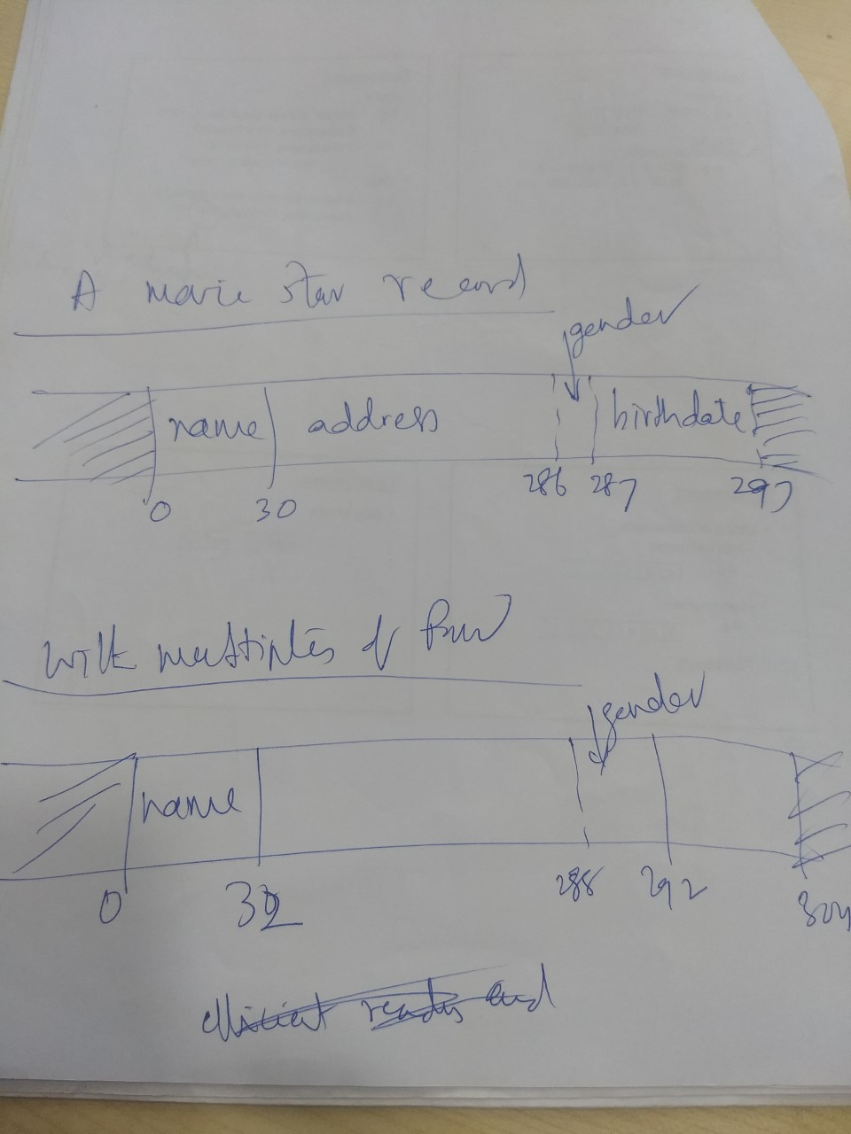

Slide 20
Record header
Designing a layout of record.
  We want to keep more information
  Pointer to schema
  Length of the record (to know the beginning of the next record)
  Timestamps indicating the time last modified
The database schema maintains schema information
  The attributes of the relation
  Their types
  The order in which attributes appear in the tuple
  Constraints on the attributes and the relation itself.
    Primary key
If we put a pointer to schema then all the information can be obtained when needed.
  Even though length can be deduced from schema, it is better to keep in the record.
To schema
length
timestamp
name
address
gender
birthdate

Slide 21
Packing Fixed-Length Records into Blocks
Records are stored in blocks of the disk and moved into main memory.
The block header holds the following
Record n
header Record2 …
Record 1
The block header holds the following information
  Links to one or more other blocks
  Information about role played by a block
  Information about which relation the tuples belongs to
  A directory giving the offset of each record in the block
  A block ID
  Timestamp, indicating the last modification to the block

Slide 22
Example: Block header
Header
A block: Free space
R3
R4
R1 R2

Slide 23
Representing Block and Record addresses
At the secondary storage, block is not a part of virtual memory address.
Sequence of bytes describes the location of the block within the overall system of data accessible to DBMS.
  Device id for disk, the cylinder number, and so on.
  A record can be identified by giving its block and the offset of the first byte of the record within the block

Slide 24
Client-server systems
Database consists of a server process that provides data from secondary storage to one or more client processes.
  Client application uses a conventional virtual address space, typically 32 bits or about 4 billion different addresses.
  OS maps virtual address space to physical addresses.
The server data lives in database address space
  The address refers to blocks
  Physical addresses
    Host address, disk id, cylinder of the disk, tracj number, block number, offset.
Logical addresses
    Arbitrary string of bytes of some fixed length.
Map table relates to logical addresses to physical addresses.

Slide 25
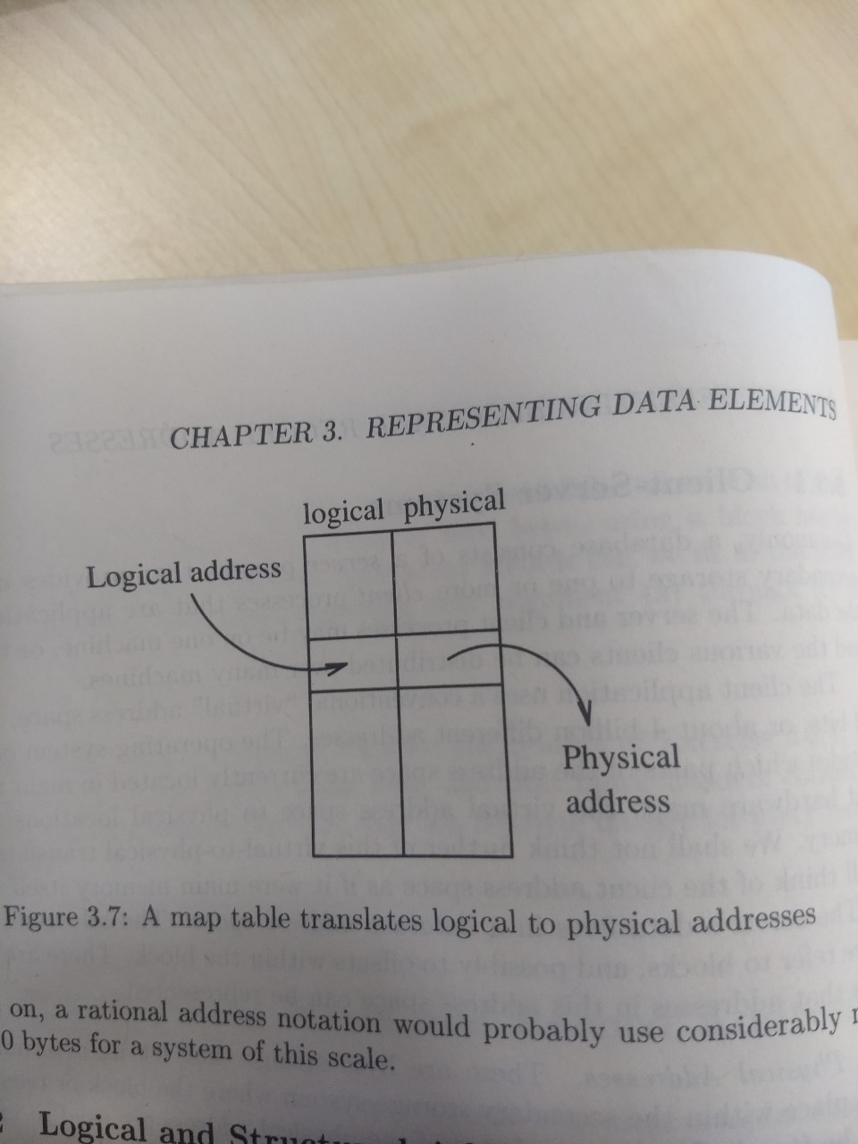

Slide 26
Regarding logical and physical addresses
May combinations are possible.
  Use physical address in the block are in the map table.
We need enough information to locate a record in the block

Slide 27
Logical and structured addresses
Table of offsets can be used to know the position of each record.
header
unused
Record 3
Record 2
Record 1
Advantages: modify block without modifying the map table.
  Modification requires only changing of record entry.
  Allow record go to other block
    Change the offset (with forward address)
  Deletion of record by writing a special character (tombstone). Pointers to this record will know tombstone. Otherwise, erroneous information can be displayed.

Slide 28
Example: Indirection in block
Header
A block: Free space
R3
R4
R1 R2

Slide 29
Two forms of addresses for every block, record, object
Database address: Address in server address space
  Sequence of 8 or so bytes which locates the item in the secondary storage.
Memory address: Address in virtual memory
  It is four bytes
Issues
  When in secondary storage we should use database address
  When in memory, we can use either database address or memory address.
  Following a database address is time consuming.
  We need a translation table

Slide 30
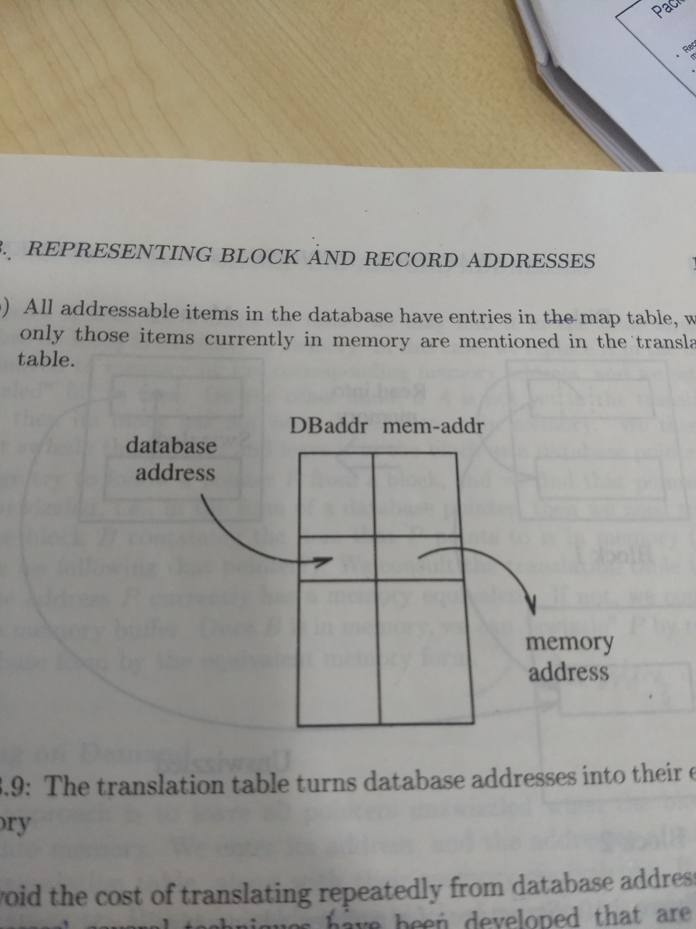

Slide 31
Pointer Swizzling
Pointers or addresses of records.
Database address
  Sequence 8 bytes to locate the item in the secondary storage
Memory address: Four bytes
The translation table maps database address to memory address.
Pointer Swizzling
  Techniques to avoid repeatedly translating of database addresses to memory addresses.
  When we move a block from secondary to main memory, pointers within the block may be swizzled, that is translates from database address space to the virtual address space. A pointer actually consists of
    A bit indicating whether pointer is a database address or a swizzeled memory address
    The database of memory pointer as appropriate
      Not all the space may not be used

Slide 32
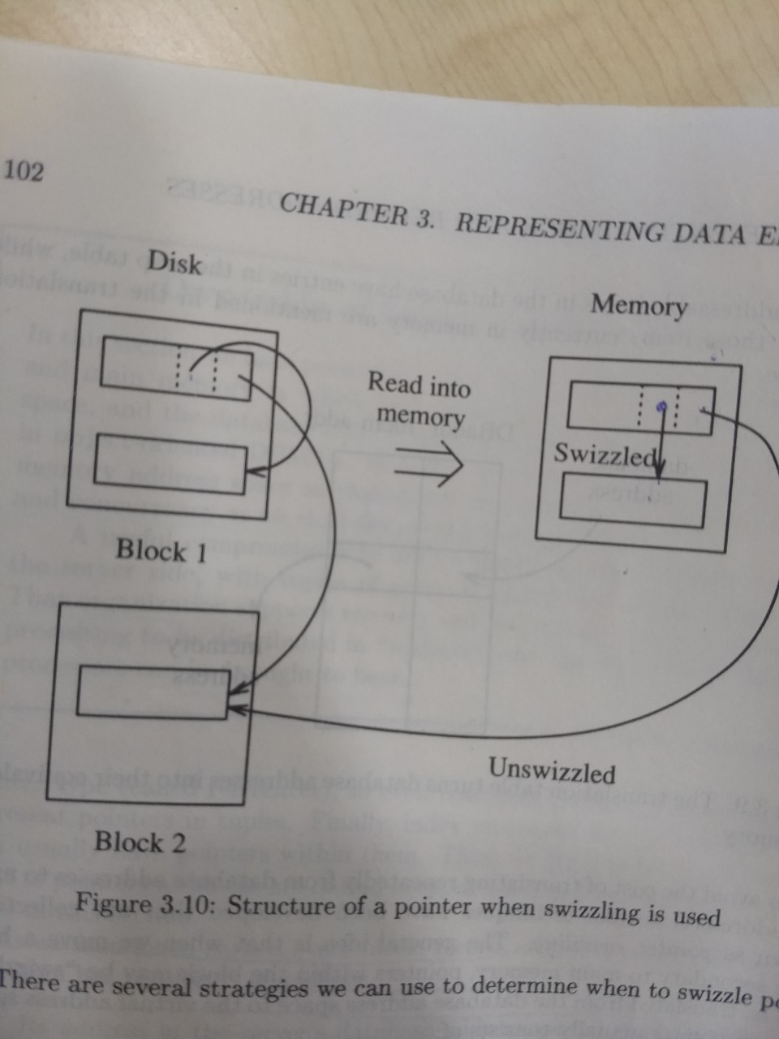

Slide 33
Swizzling strategies
Automatic swizzling
  As soon as block comes to main memory we locate all the pointers and addresses and enter into translation table.
Swizzling on demand
  Do not swizzzle when the block first brought to main memory.
  Whenever we follow a poniter we swizzle the corresponding address.
No swizzling
  Follow pointers in unswizzeled form.

Slide 34
Returning blocks to disk
When a block is moved out to disk, the pointers should be unswizzled
  Memory addresses must be relaced with corresponding database addresses
  Appropriate data structures may be employed for searching
    hash

Slide 35
Pinned Records and Blocks
Pinned block
  If we can not safely written back to disk.
    Known by reading the header of the block
If a block B1 has within it a swizzling pointer to some data item in block B2, we must be very careful moving block B2 back to disk and reusing main-memory buffer. If we move and reuse the main memory then, the pointer in B1 is dangling pointer.
  So block B2 is pinned.
So when we write blocks to disk
  Unswizzeled
  Ensure that it is not pinned.
Use indexes for searching items in translation table

Slide 36
Variable Length Data and Records
So far, fixed length and fixed schema.
Life is more complex
  Data item size varies: Ex. addresses
  Repeating fields: number of movies acted
  Variable format records: adding attributes
  Enormous fields: picture, video file

Slide 37
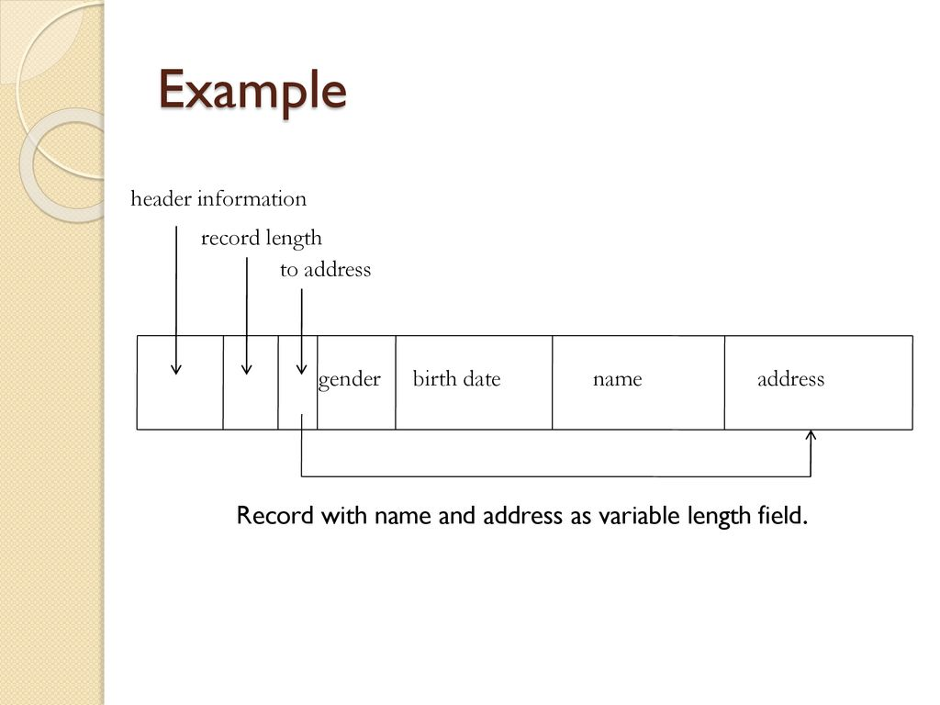
Records with Variable-Length Fields
Record header should contain
  length of the record and
  pointers (offsets) to variable length fields.

Slide 38
Records with Repeating Fields
Field itself is fixed length
  Group all the occurrences and put a pointers to the first
    Locate by adding offset
Alterative representation
  Fixed portion in one block with pointers
  Variable portion in another block
    Pointers to the place where each repeating filed begins
Searching is difficult in variable length records.

Slide 39
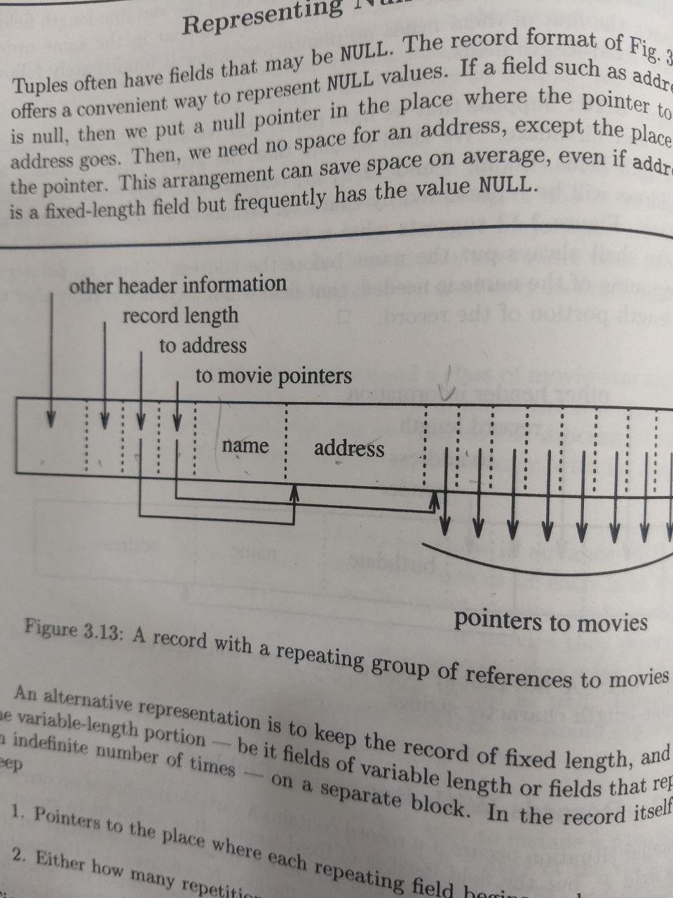

Slide 40
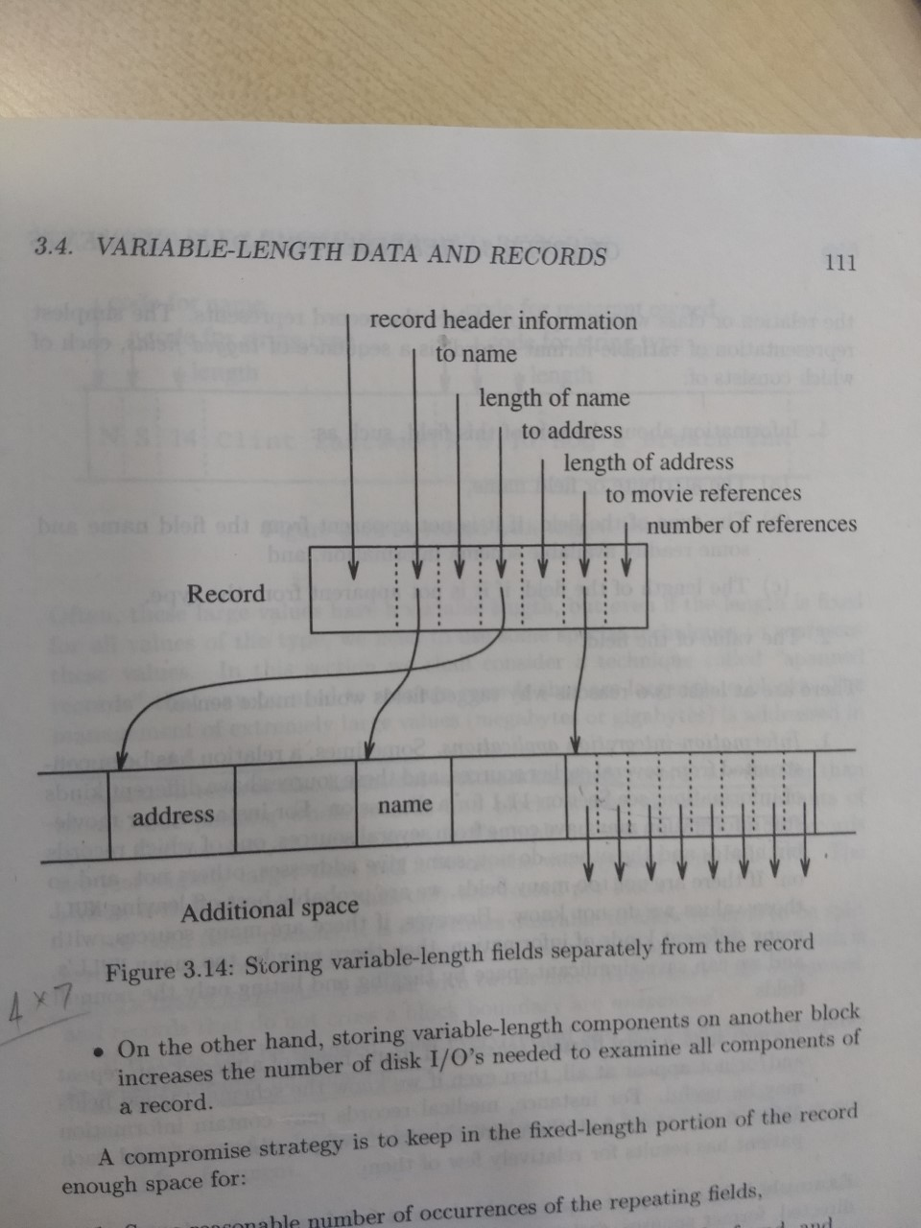

Slide 41
Variable Format Records
If schema varies ?
Order is not determined by schema ?
Simplest representation
  Sequence of tagged fields
2
# Fields
Code identifying
field as E#
Integer type
Code for Ename
String type
Length of str.
5
I
46
4
S
4
F
O
R
D

Slide 42
Records that do not fit in a block
Video clips
Allow records split among blocks
Spanned record
  A record with two or more fragments are called spanned.
Unspanned
  Records that do not cross block boundary
If the records are spanned, the header should contain more information
  A bit telling whether it is a fragment or not
  Another bot telling whether it is a first or last fragment of the record
  Pointers to the next fragment.
R1
R2
R3
(a)
R3
(b)
R4
R5
R6
R7
(a)
R1
R2
R3
R4
R5

Slide 43
BLOBS
Movies, JPEG
Stored in a sequence of blocks
  Allocate consecutive cylinders
  Stripe the BLOBLS over several disks

Slide 44
Record Modifications
Insertion
  Find the space on a nearby block B1. If there is no space find the space in the nearby block B2.
    Slide the records to B2. Maintain the sorted order
  Create an overflow block
    Each block B has a overflow pointer which points to overflow blocks

Slide 45
Free
space

Slide 46
Deletion
Delete the record and reclaim the space
If we can not slide the records, keep the maintain the available space list in the header.
  We have to take care of pointers to the deleted records.
    Place a tombstone

Slide 47
Update
Update has no effect on the storage system.
If the variable length record is updated
  Follow insertion method

Slide 48
Row vs Column Store
So far we assumed that fields of a record are stored contiguously (row store)...
Another option is to store like fields together (column store)

Slide 49
Row Store
Example: Order consists of
  id, cust, prod, store, price, date, qty

Slide 50
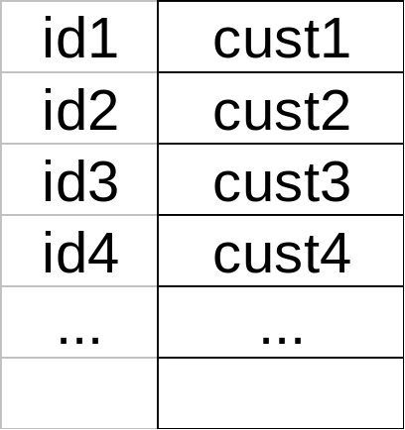
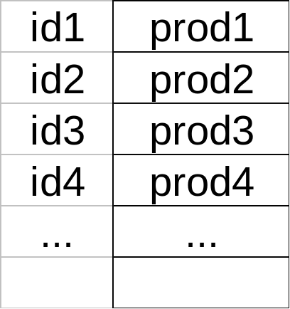
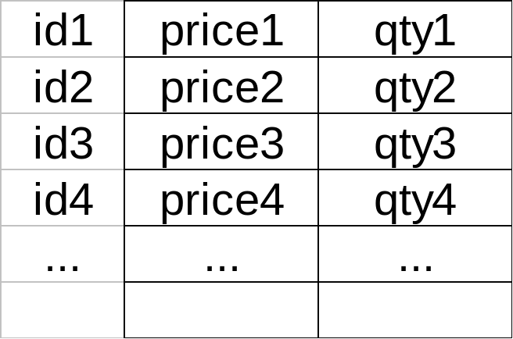
Column Store
Example: Order consists of
  id, cust, prod, store, price, date, qty
ids may or may not be stored explicitly

Slide 51
Row vs Column Store
Advantages of Column Store
  more compact storage (fields need not start at byte boundaries)
  efficient reads on data mining operations
Advantages of Row Store
  writes (multiple fields of one record)more efficient
  efficient reads for record access (OLTP)

Slide 52
Interesting paper to read:
Mike Stonebreaker, Elizabeth (Betty) O'Neil, Pat O’Neil, Xuedong Chen, et al. " C-Store: A Column-oriented DBMS," Presented at the 31st VLDB Conference, September 2005.
http://www.cs.umb.edu/%7Eponeil/
vldb05_cstore.pdf

Slide 53
Comparison
There are 10,000,000 ways to organize my data on disk…
Which is right for me?

Slide 54
Issues:
Flexibility Space Utilization
Complexity Performance

Slide 55
To evaluate a given strategy, compute following parameters:
-> space used for expected data
-> expected time to
- fetch record given key
- fetch record with next key
- insert record
- append record
- delete record
- update record
- read all file
- reorganize file

Slide 56
Example
How would you design Megatron 3000 storage system? (for a relational DB, low end)
  Variable length records?
  Spanned?
  What data types?
  Fixed format?
  Record IDs ?
  Sequencing?
  How to handle deletions?

Slide 57
Summary
How to lay out data on disk
Data Items
Records
Blocks
Files
Memory
DBMS

